Slide 1


Introduction to EEG and MEG and FieldTrip
Jörn M. Horschig
Donders Institute for Brain, Cognition and Behaviour

Slide 2
What is FieldTrip
a MATLAB toolbox for the analysis of EEG and MEG data
can import data from many different file formats
contains algorithms for event-related analysis, spectral analysis, source reconstruction and statistics

Slide 3
Talk outline
What kind of signals are generated in the brain
Analyzing those signals with FieldTrip

Slide 4
What kind of signals are generated in the brain
We measure the field associated with post-synaptic potentials in pyramidal neurons
These PSPs represent the excitatory and inhibitory input that these neurons receive
Usually we study this neuronal input following the presentation of a stimulus or following a cognitive event

Slide 5
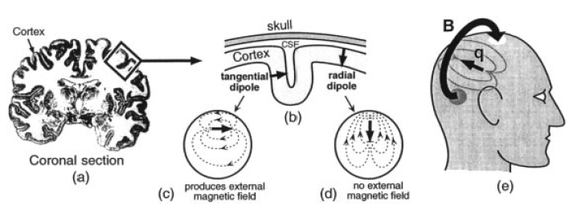
What produces the magnetic field or electric current
Vrba, 2001

Slide 6
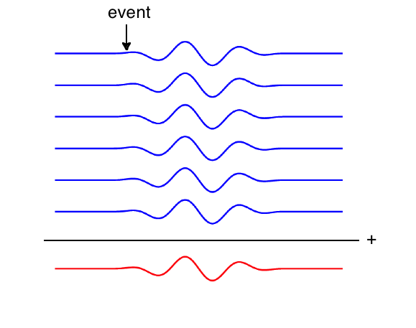
Evoked activity
repeated over
many trials
averaged

Slide 7
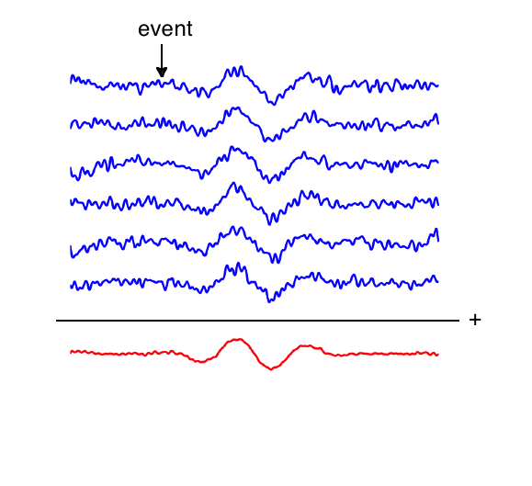
Evoked activity

Slide 8
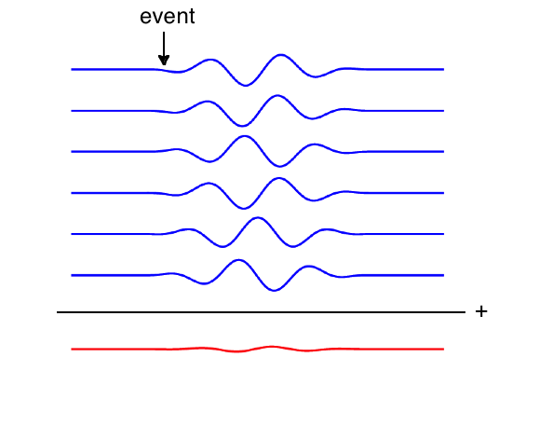
Induced activity

Slide 9
MEEG signal characteristics considered during analysis
timecourse of activity
-> ERP/ERF
spectral characteristics
-> power spectrum
temporal changes in power
-> time-frequency response (TFR)
spatial distribution of activity over the head
-> source reconstruction

Slide 10
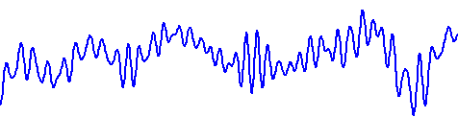
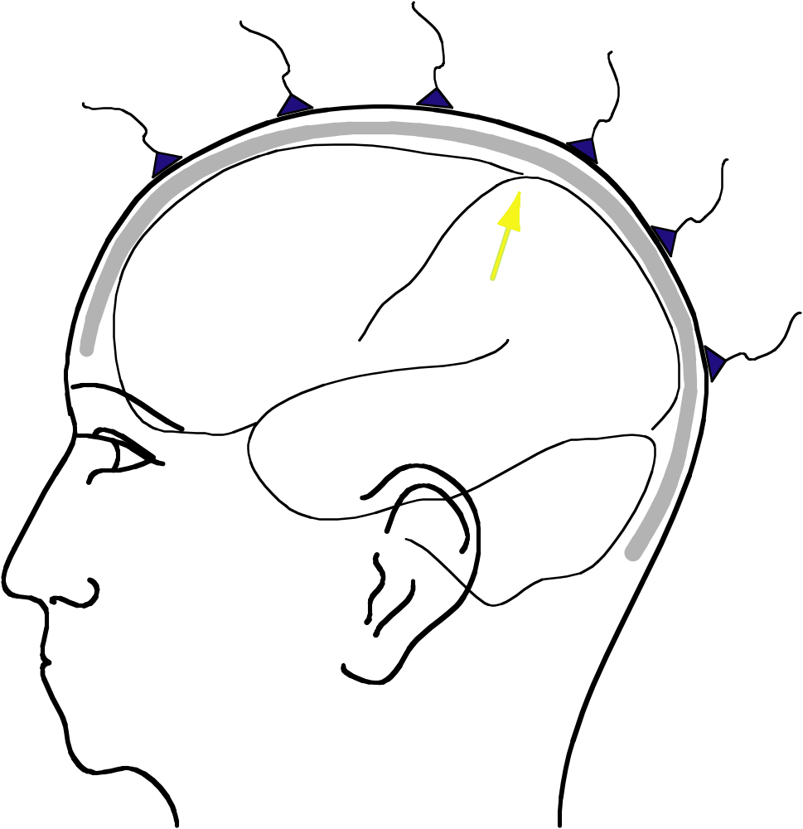
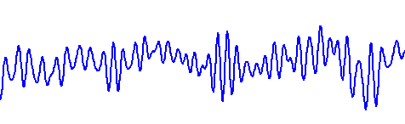
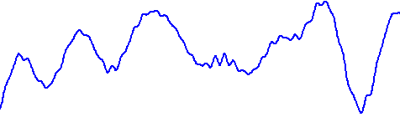
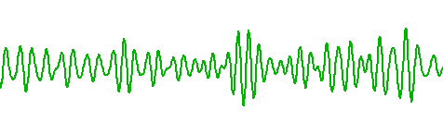
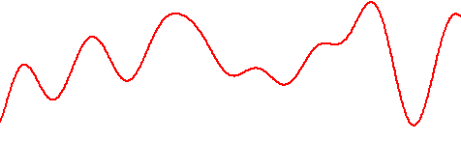
Superposition of source activity

Slide 11
Superposition of source activity
Varying “visibility” of each source to each channel
Timecourse of each source contributes to each channel
The contribution of each source depends on its “visibility”
Activity on each channel is a superposition of all source activity

Slide 12
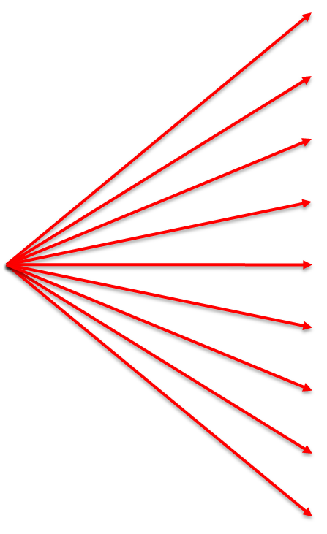
sources project their activity to the channel level
-> lead field
true source(s)
channel level
estimated source(s)

Slide 13


sources project their activity to the channel level
-> lead field
true source(s)
channel level

Slide 14

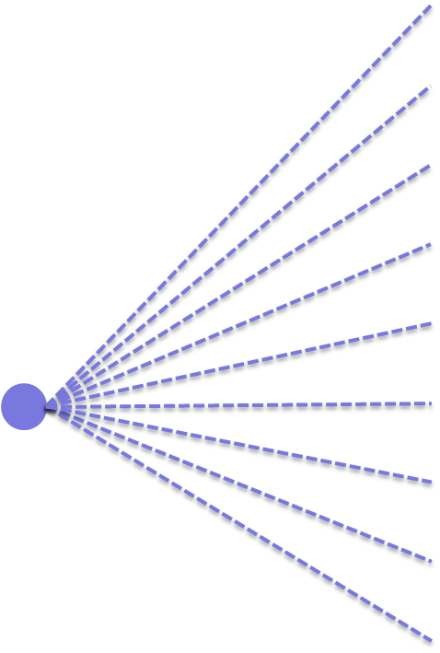
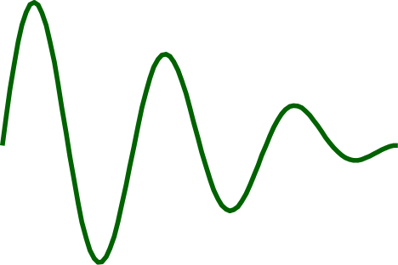
sources project their activity to the channel level
-> lead field
true source(s)
channel level

Slide 15

from the channel level we try to estimate the source activity
true source(s)
channel level
estimated source(s)

Slide 16
dipole fitting (Scherg ‘80s) -> move one or more source(s) in parameter space while minimizing the error between measurement and model
true source(s)
channel level
estimated source(s)

Slide 17
linear estimation using distributed sources
estimate the strength of many sources simultaneously
…
…
true source(s)
channel level
estimated source(s)

Slide 18
beamforming -> scan the whole source space, estimate the source strength at every location with an independent spatial filter
true source(s)
channel level
estimated source(s)

Slide 19
In general the sources linearly mix on the channel level
source strength estimation is a linear unmixing using filter weights.
leadfield
weight
L1
w1
L1
w2
…
…
true source(s)
channel level
estimated source(s)

Slide 20
Talk outline
What kind of signals are generated in the brain
Analyzing those signals with FieldTrip

Slide 21

What is FieldTrip?
A MATLAB toolbox for electrophysiological data analysis
Notes:
FieldTrip is an academic, open-source MATLAB toolbox for analysing signals, initially intended for brain signals like electroencephalography (EEG) or magnetoencephalography (MEG) or spike data.
FieldTrip started off ten years ago as a project for electrophysiological data analysis, because we at the Donders Institute wanted to analyse data in a ways that were not possible with existing tools. FieldTrip is managed by Robert Oostenveld with the help of many PhD students, postdocs and collaborators inside and outside Nijmegen. Thus, the toolbox reflects knowledge of a large group of researchers all around the world.
FieldTrip is really a toolbox, not an application; you cannot start it up and then click around in a graphical user interface. Using FieldTrip is very much like using any commercially available MATLAB toolbox. You combine the tools to do your analysis on a code-based level. That is done on the MATLAB command line or in an editor.

Slide 22
Selecting the right tools out of the toolbox
data reading
CTF, 4D, Elekta, Yokogawa
Neuroscan, BrainProducts, EGI, Biosemi, …
preprocessing
filtering, segmenting
time-locked analysis
frequency and time-frequency analysis
wavelets, multitapers, welch, hilbert
source reconstruction
beamformers, dipole fitting, linear estimation
statistical analysis
parametric, non-parametric, channel and source level
all other operations that are required around it
Notes:
FieldTrip consists of a set of functions that you can combine to do your analysis. We follow some basic concepts that facilitate working with it from the view of the user – that is you. For example, ...

Slide 23
One-to-one mapping between analysis steps and toolbox functions
Select pieces of data
ft_definetrial
Remove artifacts
ft_rejectartifact
Filter data
ft_preprocessing
Compute ERP
ft_timelockanalysis
Notes:
For example, the FieldTrip toolbox is organized to have a one-to-one mapping between how you would think of your analysis and how you would use FieldTrip functions. Let’s take this example analysis: First, select pieces of data
*SLIDE*
and then you detect and remove artefacts
*SLIDE*
Next, you might want to filter your data
*SLIDE*
and eventually compute some time-locked average
*SLIDE*
Each of these steps has a corresponding one-to-one mapped function that makes your thinking about analysis and the usage of FieldTrip natural and intuitive.
*SLIDE SLIDE SLIDE SLIDE pop up – highlight respective step and function*

Slide 24
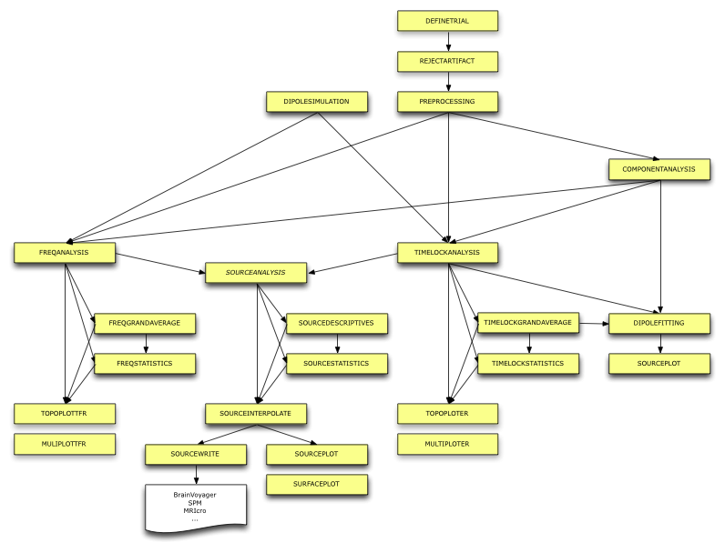
Function overview
Notes:
If you look at the broader overview of all the FieldTrip functions, you will see that there are many ways you can analyse your data
*SLIDE*
After having defined the trials to select pieces of data, we then need to preprocess our data.
*SLIDE\HGHLIGHT*
Then, there are different routes you can take. For example we could go into time-lock analysis and do a time-locked grand average and compute some statistics.
*SLIDE\HIGHLIGHT*
Alternatively, you could take your raw data to the frequency analysis branch and do your statistics in the frequency domain.
*SLIDE\HIGHLIGHT*
This is how you could think of putting the functions together. As you can see, there are many, many functions, which also means that it’s challenging to keep an overview of what functions are actually available. At the same time, this also assures that there is not much you can not do with FieldTrip. To get around in the FieldTrip toolbox, there are a number of possibilities.

Slide 25
How to use ft_ functions
ft_preprocessing
FT_PREPROCESSING reads MEG and/or EEG data according to user-specified trials and applies several user-specified preprocessing steps to the signals.
Use as
[data] = ft_preprocessing(cfg)
or
[data] = ft_preprocessing(cfg, data)
The first input argument "cfg" is the configuration structure, which
contains all details for the dataset filenames, trials and the
preprocessing options. You can only do preprocessing after defining the
segments of data to be read from the file (i.e. the trials), which is for
example done based on the occurence of a trigger in the data.
...
ft_rejectartifact
ft_freqanalysis
ft_multiplotTFR
ft_freqstatistics
ft_multiplotTFR
Notes:
As with any MATLAB toolbox you can use the MATLAB command line and type help functionname to see how to use it. In the help of each function we point to other functions that are related. This way you can easily see what steps you might want to take next. FieldTrip is open source, so you can see details of the implemented algorithm by typing edit functionname.
Also, we also have a wiki-page that contains documentation, tutorials, frequently asked questions and background information. The nature of a wiki-page is exactly what we try to achieve with FieldTrip: everyone is invited to contribute to this toolbox and its’ documentation. In general we have a large, lively and communicative community. On our email discussion list there are several hundreds of users with different level of FieldTrip experience. All those are willing to help out if you get stuck. The email discussion list is representative our community. Feel free to just ask any question there and you will have people and renowned researchers from all over the world providing you with input to help you.
Additionally, there might be a local support group, which are people directly at your own institute. They typically know what kind of experiments you are conducting in your lab, they know what kind of data you have, so asking them for advice or for help might be more efficient than asking someone on the email discussion list.

Slide 26
FieldTrip v.s. default Matlab
dataout = ft_functionname(cfg, datain, …)
cfg.key1 = value1
cfg.key2 = value2
dataout = ft_functionname(datain, ‘key1’, ‘value1’, …)
Notes:
Let’s dive a bit deeper into how to use FieldTrip. Calling of FieldTrip functions follows standard MATLAB logic, with subtle differences that are important to notice. First of all, all FieldTrip functions start with an ft_ prefix. This helps in knowing what functions there are in the toolbox.
*SLIDE*
Functionnames are chosen to reflect what they are doing. To preprocess your data, call ft_preprocessing. For computing a time-locked average, call ft_timelockanalysis. Another subtle difference pertains function calls. For example, complex MATLAB functions often operate like this
*SLIDE*
Here, we have a key with a respective value, and there another key with its respective value, and so forth - a whole sequence of input arguments. This is a style that is similar with what FieldTrip is using, but we have chosen for a slightly different style.
In FieldTrip, we use a configuration structure that contains keys and associated values, just like key-value pairs are used for MATLAB functions. So basically, this is not too much different from standard MATLAB. A function call using key-value pairs looks like this:
*SLIDE*
This is one very long line, and it’s very difficult to see what goes here. The FieldTrip style makes a function call shorter and easier to read than using key-value pairs.
*SLIDE*
This is much more natural to read. To find out what keys and values a certain function supports, you can check the help of the respective function. It’s all explained in there.

Slide 27
FieldTrip v.s. default Matlab
Matlab
plot(x, y, ‘LineWidth’, 3, ‘LineColor’, ‘red’)
FieldTrip (assuming ft_plot would exist)
cfg = [];
cfg.LineWidth = 3;
cfg.LineColor = ‘red’;
ft_plot(cfg, x, y);
Notes:
This is much more natural to read. To find out what keys and values a certain function supports, you can check the help of the respective function. It’s all explained in there.

Slide 28
Using functions in an analysis pipeline
ft_preprocessing
cfg = [ ]
cfg.dataset = ‘Subject01.ds’
cfg.bpfilter = [0.01 150]
...
rawdata = ft_preprocessing(cfg)
ft_rejectartifact
ft_freqanalysis
ft_multiplotTFR
ft_freqstatistics
ft_multiplotTFR
Notes:
Let’s show you an example. You could start with ft_preprocessing for preprocessing your data. In order to find out how to use that function, you type help ft_preprocessing in the MATLAB command line. Then you would specify the configuration; something like this:
*SLIDE*
so you would specify the dataset to read in and how to filter your data. Then you call ft_preprocessing with this configuration to read in and preprocess the raw data.
A little bit further in the analysis protocol, you might want to do frequency analysis
*SLIDE*

Slide 29
Using functions in an analysis pipeline
ft_preprocessing
ft_rejectartifact
ft_freqanalysis
cfg = [ ]
cfg.method = ‘mtmfft’
cfg.foilim = [1 120]
...
freqdata = ft_freqanalysis(cfg, rawdata)
ft_multiplotTFR
freqstatistics
ft_multiplotTFR
Notes:
and would again specify a configuration structure to call ft_freqanalysis using the configuration and the data that you obtained from the preprocessing functions.
It is important to always start with making sure that the configuration is empty. There’s not a single configuration for the full analysis pipeline; every step has its own configuration. For example, different functions have different methods. The methods of frequency analysis are different from the methods of source analysis, and there are many other options that differ between these two analysis steps. Therefore, you need different configuration structures for these analysis steps.

Slide 30
Some FieldTrip basics
dataout = functionname(cfg)
dataout = functionname(cfg, datain, …)
functionname(cfg, datain, …)
the “cfg” argument is a human-readable configuration structure, e.g.
cfg.channel = {‘C3’, C4’, ‘F3’, ‘F4’}
cfg.foilim = [1 70]
Notes:
FieldTrip functions are designed following an own rationale. All FieldTrip functions take a configuration structure as a first input argument. The configuration structure defines the details of the algorithm implemented in the FieldTrip function. Some FieldTrip functions create an output data structure by using the information provided in the configuration, for example when reading in data for the first time into MATLAB. Some other FieldTrip functions require one or multiple input data structures. Most of them produce an output data structure by using the configuration structure and the input data. For example the frequency analysis function takes a raw data and creates a frequency data representation. Some functions do not produce any output, for example, the plotting functions: they produce a figure instead.
Also, the idea behind FieldTrip syntax and code is to keep it human-readable and interpretable. For example, rather than specifying channel indices by numbers we use channel labels, because it is easier for us as humans to infer what channels are being analysed. Another example is that we indicate frequencies in Hertz and not in frequency bins. When data gets imported from any acquisition system or other programs to FieldTrip, we convert all units and descriptive labels to using this convention.

Slide 31
Structured data representation
All data is represented in separate standard MATLAB structures
as small as possible
contain all relevant details
Easy to write new functions that operate on these data structures
Output of your own functions can be further processed or plotted with FieldTrip functions
Notes:
FieldTrip data structures also follow the rationale of being human-readable We have a structured data representation with the philosophy that each data structure should be as small as possible, while being fully internally described.
We have a number of standard data structures, each for a different representation of your data. Each data structure has fields describing its’ content.

Slide 32
Raw data structure
rawData =
label: {151x1 cell}
trial: {1x87 cell}
time: {1x87 cell}
trialinfo: [87x4 double]
hdr: [1x1 struct]
cfg: [1x1 struct]
Notes:
For example let’s start with raw data. How does data look like that you just recorded:
*SLIDE*
This is an example for raw data. It’s concise, but internally self-describing and human-readable, thus self-explanatory. It has a number of fields, named according to their content. We can easily see that our data has 151 channels, each with a unique channel label. Further, we can see that there are 87 trials and each of these trials has its own time course. So, we can have trials of variable length, with each trial having its’ own time axis. Separating actual data from the time-axis makes converting data from stimulus-locked to response-locked data very easy. You just need to shift your time-axis around for each trial, while the actual data stays the same.

Slide 33
Event related response
erpData =
label: {151x1 cell}
avg: [151x900 double]
var: [151x900 double]
time: [1x900 double]
dimord: 'chan_time’
cfg: [1x1 struct]
Notes:
This is a data representation for the event-related response. It, again, has a label field describing the channels and a field containing the average of all observations. We also see the variance. Now we only have one common time-axis, because we only have the average of our trials left.
The more complex our analysis gets, the more difficult it might be to keep track of the data. That’s why the more complex data structures have a field describing the order of the data dimensions, the dimord-field. In this example, the dimension order is channels by time. Here, it is a bit redundant because we know that there are 151 channels and 900 time points. So any matrix with the size 151 by 900 can be intuitively interpreted as channels by time. But if we also had 151 time points, we would not be able to know how to interpret that 151 by 151 matrix. How to know whether channels are represented in the row or in the column vector?
*SLIDE?*
So a dimord-field tells us how FieldTrip has ordered our data and how to interpret the dimensions.
Also you see that there is a configuration structure in each of the FieldTrip data structures.

Slide 34
Provenance: Keeping track of your data and analysis
user’s analysis code binds the analysis steps together
cfg structure keeps history
dataout = functionname(cfg, datain{1}, datain{2},…)
dataout = data structure with…
dataout.cfg = settings + defaults
dataout.cfg.previous{1} = datain{1}.cfg
dataout.cfg.previous{2} = datain{2}.cfg
…
details of computations are kept with data
history can be reconstructed using cfg.previous.previous…
or using the ft_analysispipeline function
Notes:
There is an intrinsic relationship between the configuration and your data. The configuration has defined the peculiarities of the algorithm to create your data structure. So, the configuration structure contains the history of what has been done. So, imagine we have a function-call like this
*SLIDE?*
with dataout as a data structure with the result of the analysis. dataout contains the configuration that was used to produce this data. This configuration does not only contain all settings that you specified yourself; it also contains default values that the function is using.
Furthermore, the configuration also contains previous configurations in dataout.cfg.previous. For multiple input arguments, the configuration of the first input argument is represented in the first previous element, and of the second input argument in the second previous element and so forth.
*SLIDE*
This way, all details of your analysis are always contained in the data. So, FieldTrip helps you to remember what you did! Imagine that you tried out different versions of an analysis by tweaking several parameters to optimize it. Sometime later, you might not remember anymore what parameters you used to produce the best result. FieldTrip allows you to load those data and reconstruct what you’ve actually been computing by using the previous field in the configuration enclosed in the data. Also, it allows you to report back on the analysis in full detail, and get a deeper understanding on what is going on in the background of some algorithms by containing default settings that you have not been aware of.

Slide 35
Keeping track of your analysis pipeline: ft_analysispipeline
history can be reconstructed using the ft_analysispipeline function:
ft_analysispipeline([], data) will create such a plot
ft_definetrial
ft_preprocessing
cfg = [ ]
cfg.dataset = ‘Subject01.ds’
cfg.bpfilter = [0.01 150]
ft_freqanalysis
ft_freqstatistics
Notes:
FieldTrip has a function to reconstruct your analysis pipeline from data, called ft_analysispipeline. You can pass one FieldTrip data structure as input and it will show you how that structure came into existence. This is very helpful in double-checking your analysis steps or when sharing your FieldTrip experience with a colleague or a student.

Slide 36
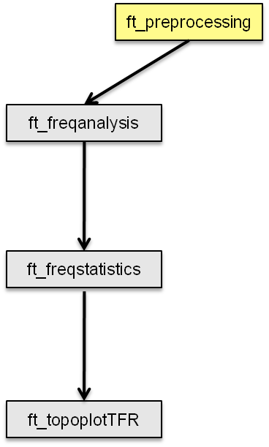
Example use in scripts
cfg = []
cfg.dataset = ‘Subject01.ds’
cfg.bpfilter = [0.01 150]
...
rawdata = ft_preprocessing(cfg)
cfg = []
cfg.method = ‘mtmfft’
cfg.foilim = [1 120]
...
freqdata = ft_freqanalysis(cfg, rawdata)
cfg = []
cfg.method = ‘montecarlo’
cfg.statistic = ‘indepsamplesT’
cfg.design = [1 2 1 2 2 1 2 1 1 2 ... ]
...
freqstat = ft_freqstatistics(cfg, freqdata)
…
Notes:
Let’s recapitulate on what we just explained. In FieldTrip, you use a configuration to define the details of the function that you are calling. Using this configuration, you define how a function operates on your data structure. Each single function call represents one step in your analysis pipeline. Thus, your whole analysis pipeline can be represented in a MATLAB script collecting all FieldTrip function calls. Let’s talk a bit about benefits of using a script.
First of all, keeping all your code in a script helps you to keep an organized overview about what you are doing. Also, often you are doing the same analysis steps for all your subjects and different conditions. If you want to perform the same computation steps for each subject and condition, you can easily set up a for-loop. This makes your analysis very efficient. Let’s take again our example analysis steps

Slide 37
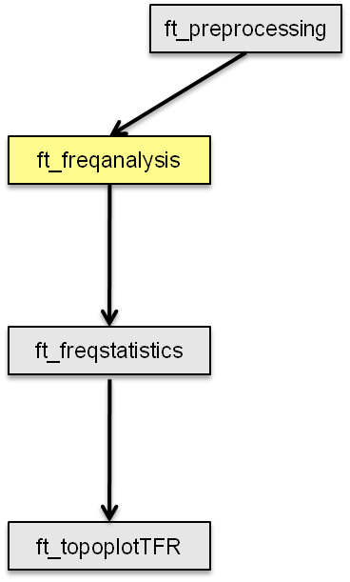
Example use in scripts
cfg = []
cfg.dataset = ‘Subject01.ds’
cfg.bpfilter = [0.01 150]
...
rawdata = ft_preprocessing(cfg)
cfg = []
cfg.method = ‘mtmfft’
cfg.foilim = [1 120]
...
freqdata = ft_freqanalysis(cfg, rawdata)
cfg = []
cfg.method = ‘montecarlo’
cfg.statistic = ‘indepsamplesT’
cfg.design = [1 2 1 2 2 1 2 1 1 2 ... ]
...
freqstat = ft_freqstatistics(cfg, freqdata)
Notes:
followed by frequency analysis,

Slide 38
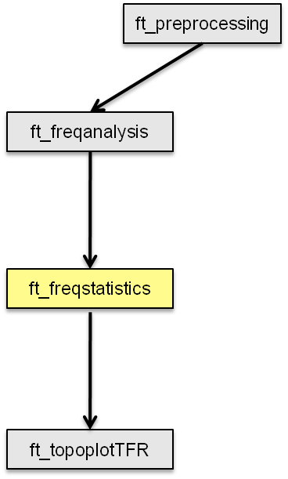
Example use in scripts
cfg = []
cfg.dataset = ‘Subject01.ds’
cfg.bpfilter = [0.01 150]
...
rawdata = ft_preprocessing(cfg)
cfg = []
cfg.method = ‘mtmfft’
cfg.foilim = [1 120]
...
freqdata = ft_freqanalysis(cfg, rawdata)
cfg = []
cfg.method = ‘montecarlo’
cfg.statistic = ‘indepsamplesT’
cfg.design = [1 2 1 2 2 1 2 1 1 2 ... ]
...
freqstat = ft_freqstatistics(cfg, freqdata)
Notes:
statistics

Slide 39
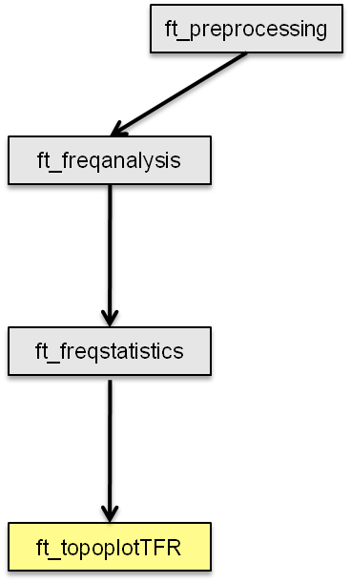
Example use in scripts
cfg = []
cfg.dataset = ‘Subject01.ds’
cfg.bpfilter = [0.01 150]
...
rawdata = ft_preprocessing(cfg)
cfg = []
cfg.method = ‘mtmfft’
cfg.foilim = [1 120]
...
freqdata = ft_freqanalysis(cfg, rawdata)
cfg = []
cfg.method = ‘montecarlo’
cfg.statistic = ‘indepsamplesT’
cfg.design = [1 2 1 2 2 1 2 1 1 2 ... ]
...
freqstat = ft_freqstatistics(cfg, freqdata)
Notes:
and finally plotting your results.

Slide 40
Example use in scripts
cfg = []
cfg.dataset = ‘Subject01.ds’
cfg.bpfilter = [0.01 150]
...
rawdata = ft_preprocessing(cfg)
cfg = []
cfg.method = ‘mtmfft’
cfg.foilim = [1 120]
...
freqdata = ft_freqanalysis(cfg, rawdata)
cfg = []
cfg.method = ‘montecarlo’
cfg.statistic = ‘indepsamplesT’
cfg.design = [1 2 1 2 2 1 2 1 1 2 ... ]
...
freqstat = ft_freqstatistics(cfg, freqdata)
ft_preprocessing
ft_freqanalysis
ft_freqstatistics
Notes:
Let’s focus on this small part for now

Slide 41
Example use in scripts
subj = {‘S01.ds’, ‘S02.ds’, …};
cond = [1 3 7 9];
for s=1:nsubj
for c=1:ncond
cfg = [] ;
cfg.dataset = subj{s};
cfg.trigger = cond(c);
cfg.bpfilter = [0.01 150];
rawdata{s,c} = ft_preprocessing(cfg);
cfg = [];
cfg.method = ‘mtmfft’
cfg.foilim = [1 120];
freqdata{s,c} = ft_freqanalysis(cfg, rawdata{s,c});
end
end
Notes:
By setting up a for-loop, we can perform all these steps for all subjects and different conditions. Then, this becomes a script that you can just switch on in the evening; your computer will be churning through the data all night long, and the next morning your analysis is done. Also, you can easily scale up your analysis by including more fancy analysis techniques later and run the script again.

Slide 42
FieldTrip is a toolbox
the data and the separate functions are in the hands of the end-users
the scripts depend on the data properties, available memory and programming skills and style
scripts correspond to analysis protocols
  scripts can be reviewed by supervisors
  scripts are often shared with colleagues
Notes:
Basically, that explains pretty much what FieldTrip is and what you can use it for. Let me end with some words about getting started with FieldTrip. FieldTrip is designed to facilitate working together. All scripts you are writing of course depend on your data, but it also depends on your personal preferences and your programming skills. Scripts can easily be shared among colleagues, or can be reviewed by supervisors. If you need advice, this is an easy and fast way to communicate what you have been doing.
Initially, you will need to spend some time for learning how to use FieldTrip. And also, you will need to develop your programming skills. In the long run, you will realize that this tremendously helps understanding what exactly you are doing. This is a very important aspect of FieldTrip: Understanding what is happening and being able to infer what has been done by sharing scripts and configuration structures.

Slide 43
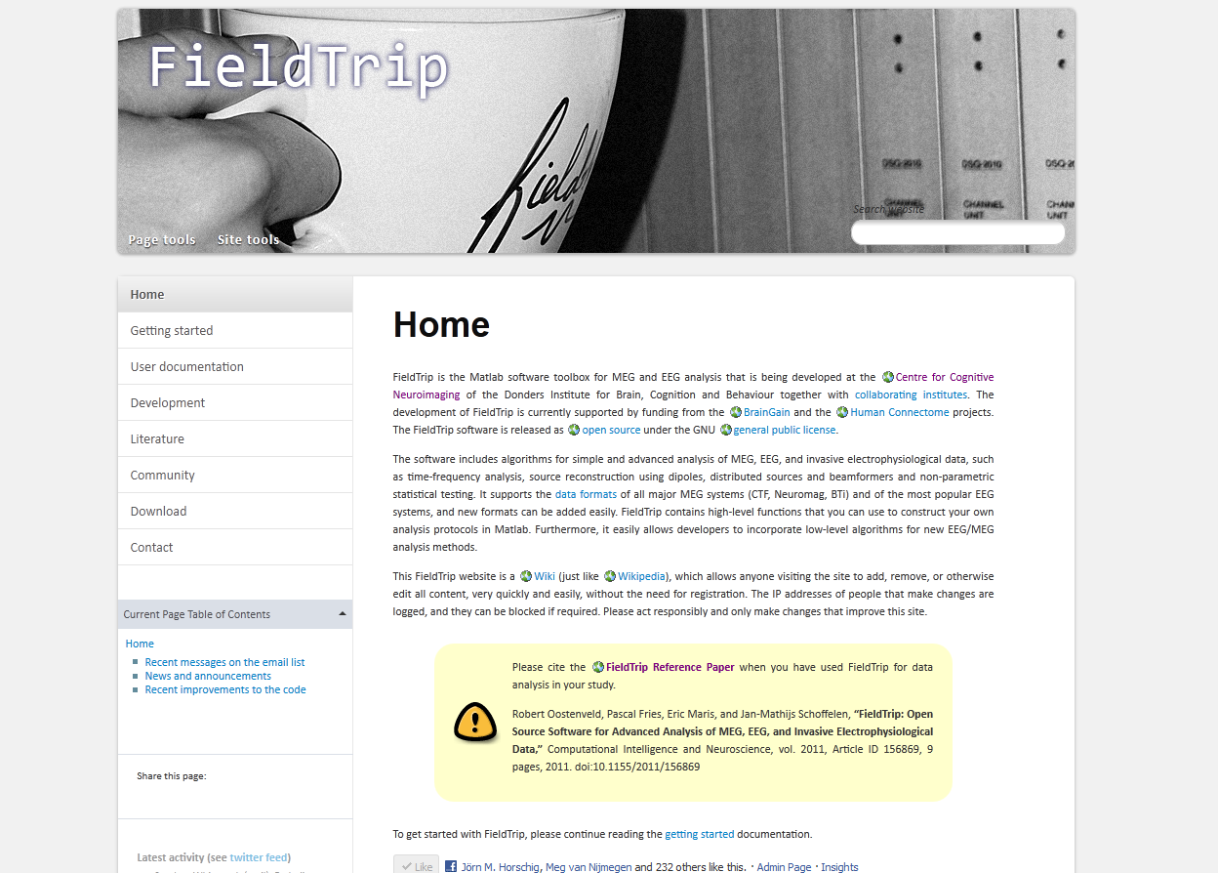
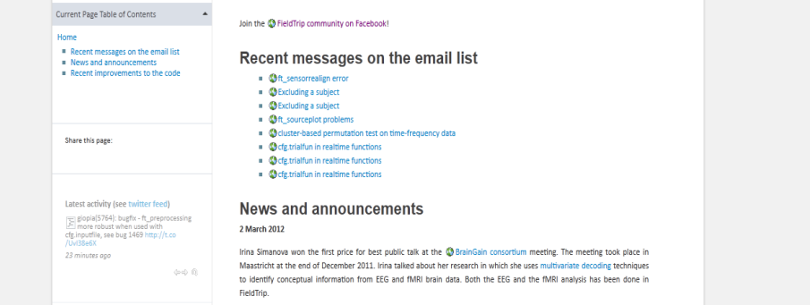
Finding your way around in the documentation
Matlab
  help ft_functionname
  edit ft_functionname
Website
  http://www.ru.nl/donders/fieldtrip (official)
  http://fieldtrip.fcdonders.nl (inofficial)
  wiki
Email discussion list
Local support groups

Slide 44
Who is the audience?
experimental neuroscientists
  no graphical user interface
  more experienced users
developers of other software packages
  SPM8
  EEGLAB
  ERP/PCA lab
  BESA research
  BCI2000
Notes:
we are using it for the analysis of our data, which is collected by a large number of PhD students and PostDocs at the Donders institute
no gui, direct matlab command line, less suitable for the casual user
advanced algorithms, requires a basic understanding
… that are willing to invest time in understanding the methods that they are using

Slide 45
Development model
Daily updates
  fieldtrip_YYYYMMDD.zip
Joint development
  EEGLAB
  SPM8
Modularisation

Slide 46
FieldTrip toolbox structure - at a glance
end-user
perspective
FieldTrip main functions
FieldTrip private functions
(low-level)

Slide 47
FieldTrip toolbox structure - a closer look
end-user
perspective
public
FieldTrip main functions
fileio
forward
preproc
multivar.
distrib.
comput.
private

Slide 48
Summary
What kind of signals are generated in the brain
Analyzing those signals with FieldTrip
Hands-on
Selecting pieces of data
Preprocessing
Averaging
Plotting

